Slide 1




Varun Mamindla
Lakshmi Gorijala
Anusha Maddali

Slide 2
Final Presentation: Outline
Application Scope
UI & MVC Design
Frameworks Used
Demo
Task Division
Conclusions

Slide 3
Application Scope
iExpensify is the app with which we can keep track of our day to day expenses. This app helps us to share the bill among friends and helps us to track the details.
New members can be added from the list of your phone contacts. Once the bill is shared among the friends, user will be able to see the details of the expense shared.
New bills can be added based on the category. User will be able to view the details of the added bill and can clear, edit and delete the bills.

Slide 4
Application Scope(Contd)
User is given access to add an image of the expense using the photo library.
The expense can be cleared or the friend can be deleted which will remove all the expenses with that contact.
Report generation is the key feature which helps users to get the details of the monthly expenditure in a spreadsheet form and can be sent via email.

Slide 5
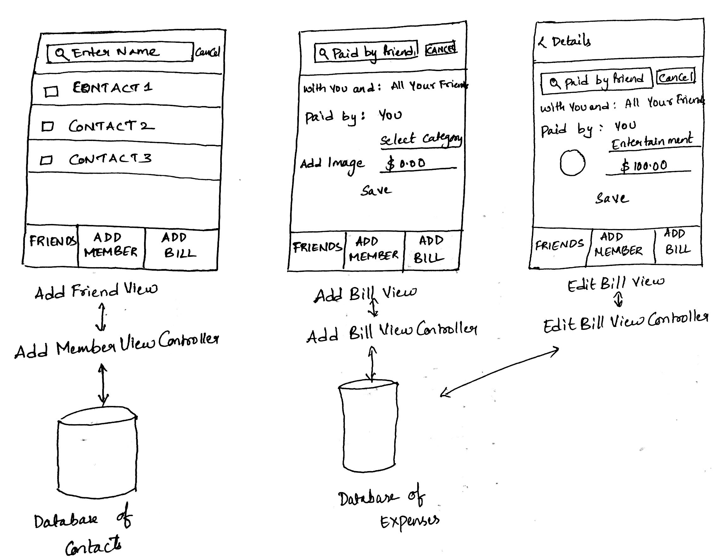
MVC Design

Slide 6
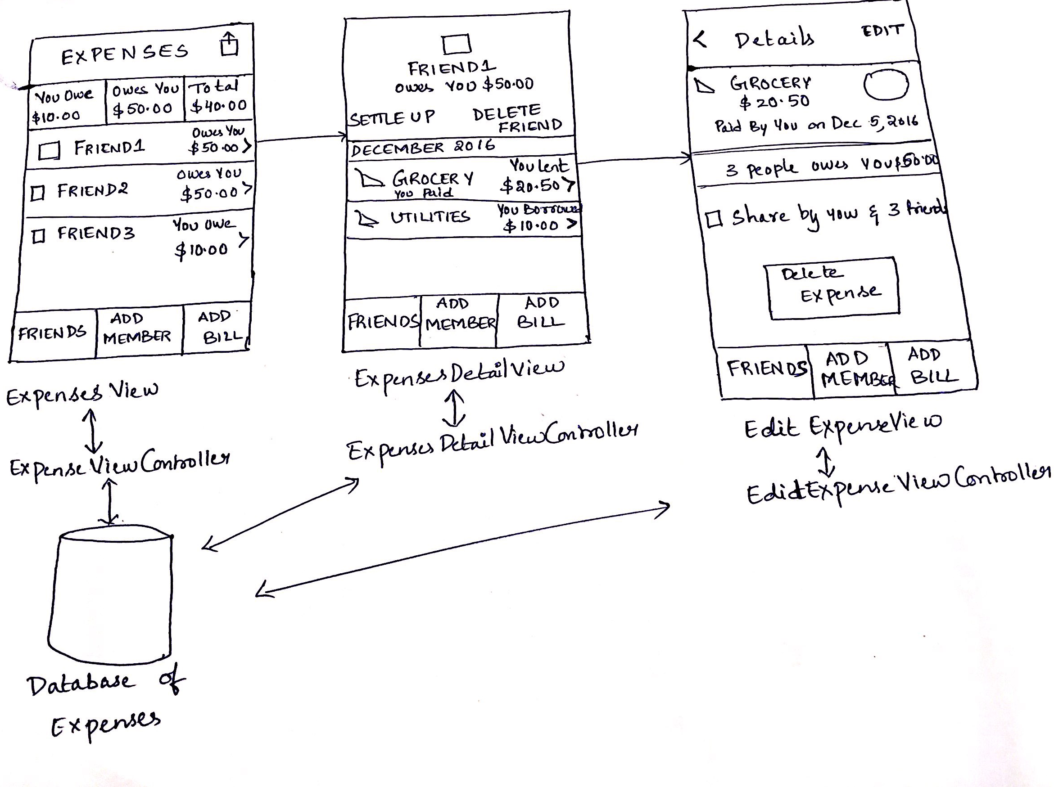
MVC Design(Contd)

Slide 7
Framework
The basic framework for implementing this application includes:
Cocoa Touch framework
UIKit.framework
Foundation.framework
CoreData.framework
MessageUI.framework

Slide 8
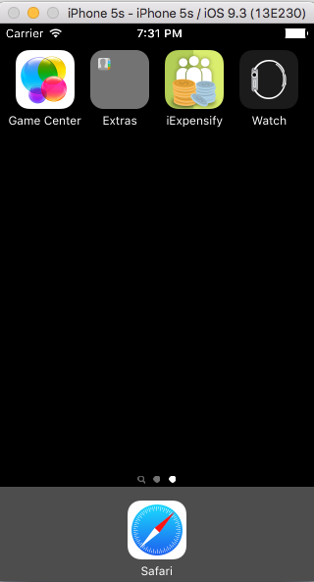
Demo
Go to XCODE

Slide 9
Task Division
FriendsDetailView - Varun, Anusha, Charita
ExpensesListView - Varun
ExpenseDetailView - Anusha, Charita
AddMemberView - Varun
AddBillView - Varun, Charita
EditBillView - Anusha, Varun
DeleteFriend - Anusha
SettleUp - Varun, Anusha

Slide 10
Timeline
Feature | Start Date | End Date
Wireframes/Mockups | September 13 | September 27
MVC Design | September 28 | October 4
FriendsDetailView Design Tab Bar Controller Table View Controller | October 5 | October 6
ExpensesListView Design - Table View Controller | October 7 | October 8
ExpenseDetailView Design | October 9 | October 12

Slide 11
Timeline(Contd)
Feature | Start Date | End Date
AddMemberView Design Search Bar Control Table View Controller | October 9 | October 12
AddBillView Design Search Bar Control Picker Control | October 13 | October 15
EditBillView Design Search Bar Control Picker Control | October 15 | October 17

Slide 12
Timeline(Contd)
Feature | Start Date | End Date
Database Design | October 20 | October 23
Delete Friend, SettleUp | October 23 | October 25
GenerateReportView Design | October 25 | October 29
ExpensesView Development | October 29 | November 3
FriendsDetailView Development | November 3 | November 5

Slide 13
Timeline(Contd)
Feature | Start Date | End Date
ExpenseDetailView Development | November 5 | November 7
AddMemberView Development | November 8 | November 10
AddBillView Development | November 11 | November 15
EditBillView Development | November 16 | November 20
GenerateReportView Development | November 20 | November 24

Slide 14
Timeline(Contd)
Feature | Start Date | End Date
Graphical User Interface Updation | November 24 | November 29
Testing & Fixing Crashes | November 29 | December 2

Slide 15
Conclusions
Restricted sharing bill between more than four members to avoid conflicts in the later parts of the app while editing and deleting the bills.
Due to the Xcode compatibility issue we were not able to show the email notification.
Inserting a sub view inside a main view was challenging while deigning the UI.
Complex calculations were involved while settling up the bill and sharing the bill among friends. Each detail has to be considered carefully.
Designing the email template was challenging.

Slide 16
Thank You

